Slide 1
MULTI LAYERED CLIENT-SERVER
ENCRYPTION
DECRYPTION
INFORMATION SECURITY LAB

Slide 2
SUBMITTED BY
SUBMITTED TO
Pranav Gupta 19803021
Khushboo Kumari 19803003
Kanistha 19803008
Kanishka Khullar 19803011
SOMYA JAIN MA’AM

Slide 3
LAYER 1
01
Vigenère Cipher

Slide 4
Vigenère Cipher
Vigenere Cipher is a method of encrypting alphabetic text. It uses a simple form of polyalphabetic substitution. A polyalphabetic cipher is any cipher based on substitution, using multiple substitution alphabets. The encryption of the original text is done using the Vigenère square or Vigenère table.
The table consists of the alphabets written out 26 times in different rows, each alphabet shifted cyclically to the left compared to the previous alphabet, corresponding to the 26 possible Caesar Ciphers.
At different points in the encryption process, the cipher uses a different alphabet from one of the rows.
The alphabet used at each point depends on a repeating keyword.

Slide 5
LAYER 2
02
Transposition Cipher

Slide 6
Transposition Cipher
Vigenere Cipher is a method of encrypting alphabetic text. It uses a simple form of polyalphabetic substitution. A polyalphabetic cipher is any cipher based on substitution, using multiple substitution alphabets. The encryption of the original text is done using the Vigenère square or Vigenère table.
The table consists of the alphabets written out 26 times in different rows, each alphabet shifted cyclically to the left compared to the previous alphabet, corresponding to the 26 possible Caesar Ciphers.
At different points in the encryption process, the cipher uses a different alphabet from one of the rows.
The alphabet used at each point depends on a repeating keyword.

Slide 7
LAYER 3
03
Columnar Transposition

Slide 8
Columnar Transposition
The Columnar Transposition Cipher is a form of transposition cipher. Columnar Transposition involves writing the plaintext out in rows, and then reading the ciphertext off in columns one by one. It builds in a keyword to order the way we read the columns, as well as to ascertain how many columns to use.
The message is written out in rows of a fixed length, and then read out again column by column, and the columns are chosen in some scrambled order.
Width of the rows and the permutation of the columns are usually defined by a keyword.
For example, the word HACK is of length 4 (so the rows are of length 4), and the permutation is defined by the alphabetical order of the letters in the keyword. In this case, the order would be “3 1 2 4”.
Any spare spaces are filled with nulls or left blank or placed by a character (Example: _).
Finally, the message is read off in columns, in the order specified by the keyword.

Slide 9
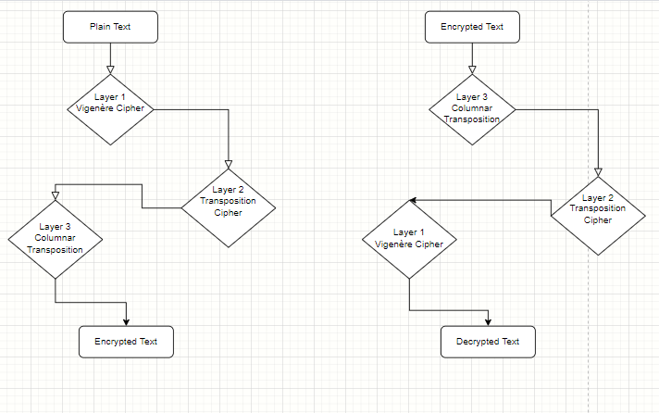
FLOWCHART

Slide 10
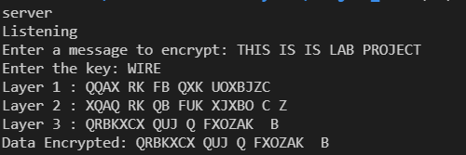
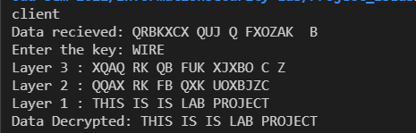
SCREENSHOTS

Slide 11
THANKS!

